Slide 1


DEPARTMENT OF ARTIFICIAL INTELLIGENCE AND MACHINE LEARNING
SCHOOL OF COMPUTING
10214AM602 MINOR PROJECT –II
WINTER SEMESTER(2025-2026)
REVIEW-II
“AI-BASED STUDENT PERFORMANCE PREDICTION ANDCAREER READINESS SYSTEM”
SUPERVISED BY
PRESENTED BY
Dr. S.ALEX DAVID
Professor Head
SRI DEEKSHITHA GUMMALLA (23UEAM2008) (VTU28350)
ESWAR VENKAT KASTURI (23UEAM2003) (VTU28351)

Slide 2
OVERVIEW
ABSTRACT
OBJECTIVE
INTRODUCTION
LITERATURE REVIEW (SOFT COPY OF PAPERS TO BE LINKED AS HYPERLINK)
DESIGN AND METHODOLOGIES
IMPLEMENTATION
TESTING
RESULT
PROJECT EXECUTION DEMO VIDEO(Complete Implementation of Project)
CONCLUSION
WEB REFERENCES LINK (TILL REVIEW DATE ALL LINKS TO BE INCLUDED DAY WISE)
PLAGIARISM REPORT OF PPT
REFERENCES

Slide 3
ABSTRACT
Improves students’ placement chances using AI
Analyzes academic performance, skills, and domain interests
Predicts placement readiness
Includes AI-driven assessment module
Generates domain-specific tests
Identifies strengths and weaknesses
Provides personalized feedback
Recommends relevant learning resources
Creates a day-wise improvement roadmap
Uses test performance and input data for analysis

Slide 4
OBJECTIVES(
Aim of the Project
To develop an AI-based system for predicting student placement readiness
To analyze academic performance, skills, and domain interests
To assess students using AI-generated domain-specific tests
To identify strengths and weaknesses of students
To provide personalized feedback and improvement strategies
Scope of the Project
Applicable for students preparing for campus placements
Can be used by colleges and training institutions
Supports multiple domains (IT, core, etc.)
Provides real-time performance analysis and prediction
Helps in continuous skill assessment and improvement

Slide 5
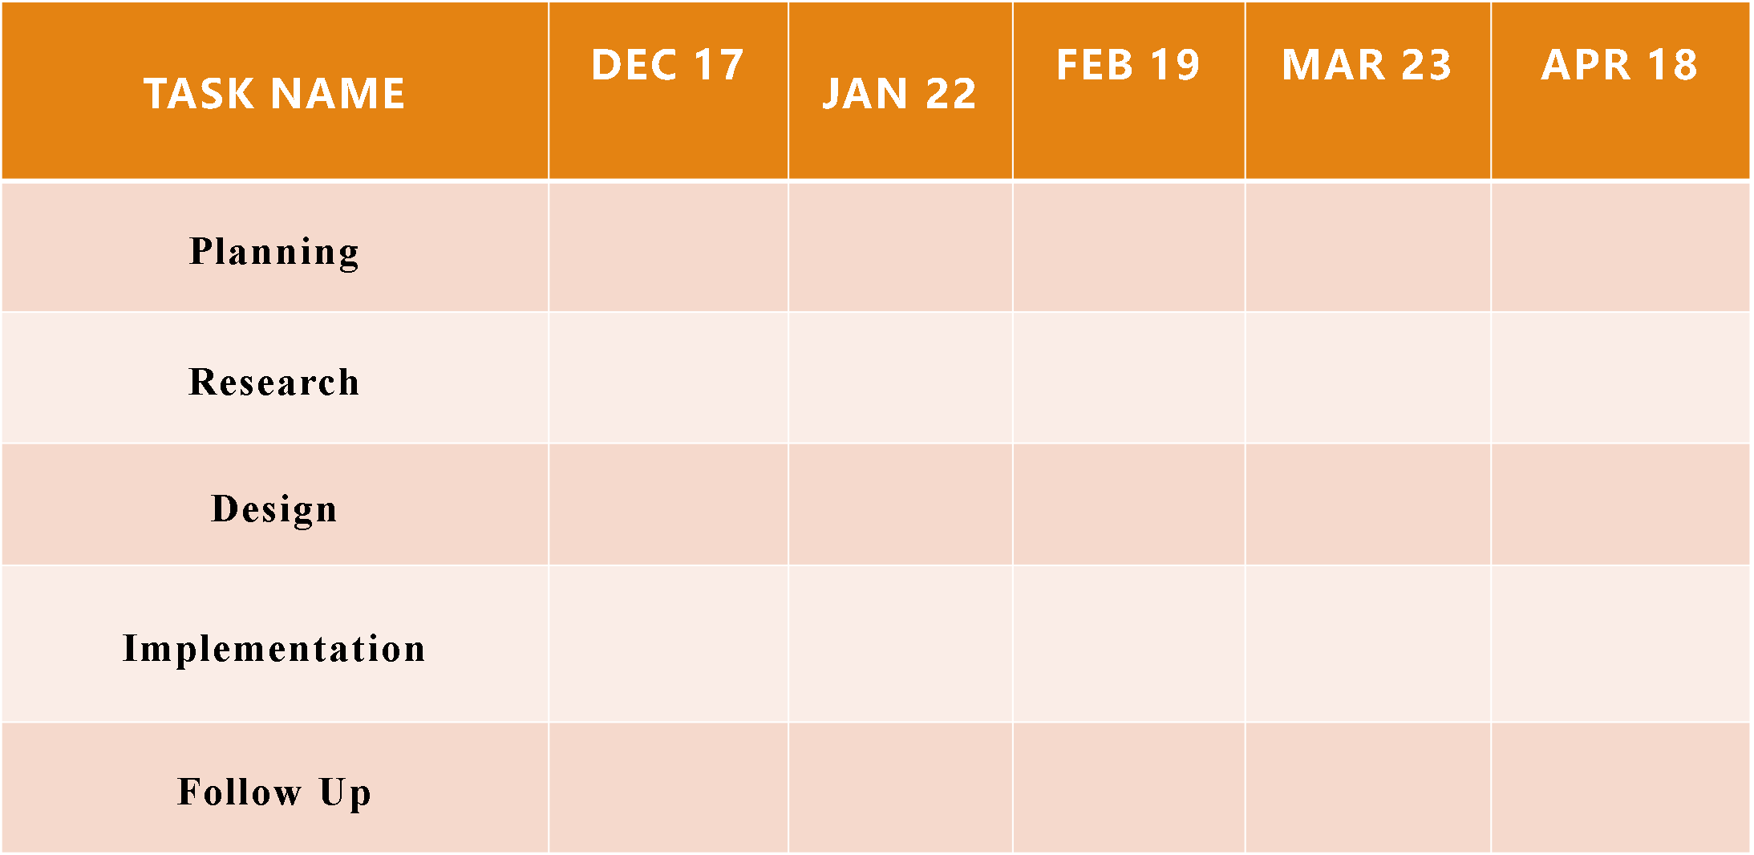
TIMELINE OF THE PROJECT

Slide 6
INTRODUCTION
“What if an AI system could predict your placement success and guide you step-by-step to achieve it?”
The project focuses on building an AI-Powered Student Performance and Placement Readiness System
Designed to bridge the gap between academic learning and industry requirements
Traditional systems only evaluate marks, but this system goes further by analyzing skills, interests, and practical knowledge
Uses AI to generate domain-specific tests to assess real understanding
Provides personalized feedback instead of generic evaluation

Slide 7
LITERATURE REVIEW
Sl.No | Author’s Name | Paper name and publication details | Year of publication | Main content of the paper
1 | A. Kumar, R. Singh | Student Performance Prediction Using Machine Learning, IEEE Conference on AI & Data Science | 2019 | Uses ML algorithms to predict student academic performance based on past data
2 | S. Patel, M. Shah | An Intelligent System for Placement Prediction, IEEE International Conference on Computing | 2020 | Predicts placement chances using student skills, grades, and aptitude scores

Slide 8
Sl.No | Author’s Name | Paper name and publication details | Year of publication | Main content of the paper
3 | J. Lee, K. Park | AI-Based Adaptive Learning and Assessment System, IEEE Access Journal | 2021 | Introduces AI-driven tests and personalized learning recommendations
4 | P. Verma, S. Gupta | Cloud-Based Student Analytics System for Career Guidance, IEEE Cloud Computing Conference | 2023 | Uses cloud storage and analytics to track student progress and suggest career paths

Slide 9
MODULE 1: Student Input and Test Module
This module is responsible for collecting student information and conducting assessment tests. Itprovides an interactive interface where students can enter their personal details, academic background,skills, and domain of interest. The module ensures proper validation of input data to maintain accuracyand consistency.Once the input is collected, the module interacts with the AI engine to generate domain-specific testquestions. These questions are displayed to the student in a structured format. The module alsohandles user interactions during the test, such as selecting answers and submitting responses.The design of this module focuses on usability and responsiveness, ensuring a smooth user experience.It acts as the entry point of the system and plays a crucial role in data collection and test execution.

Slide 10
Module 2- Evaluation and Analysis Module
This module is responsible for evaluating student responses and analyzing performance. It processesthe submitted answers and calculates the score based on the number of correct responses. The evalu-ation logic ensures accuracy and consistency in scoring.After calculating the score, the module sends the data to the AI engine for further analysis. The AIengine identifies weak areas and strengths by analyzing the performance data. This module plays acritical role in transforming raw data into meaningful insights.

Slide 11
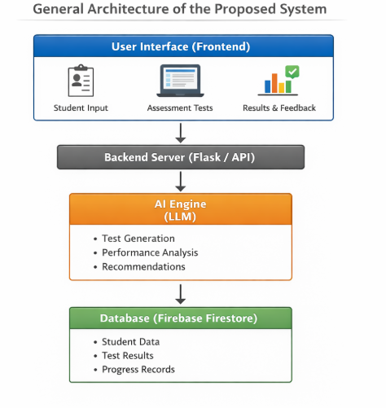
Architecture Diagram

Slide 12
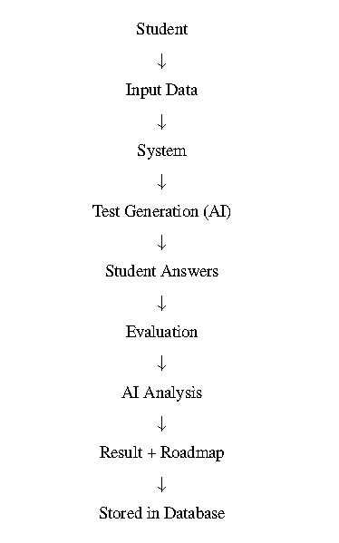
Data –Flow Diagram

Slide 13
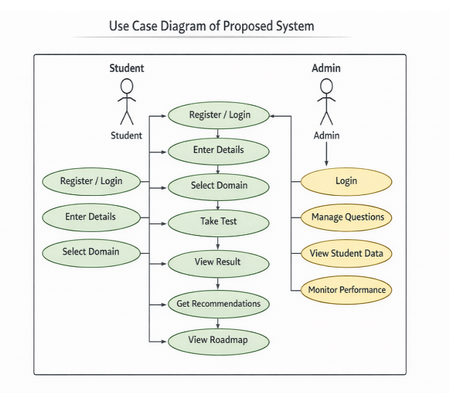
Use Case Diagram

Slide 14
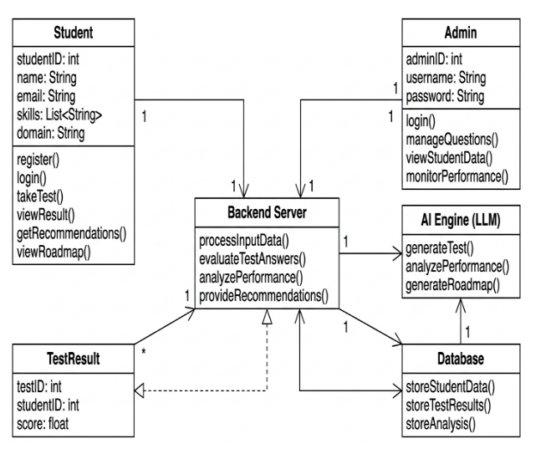
Class Diagram

Slide 15
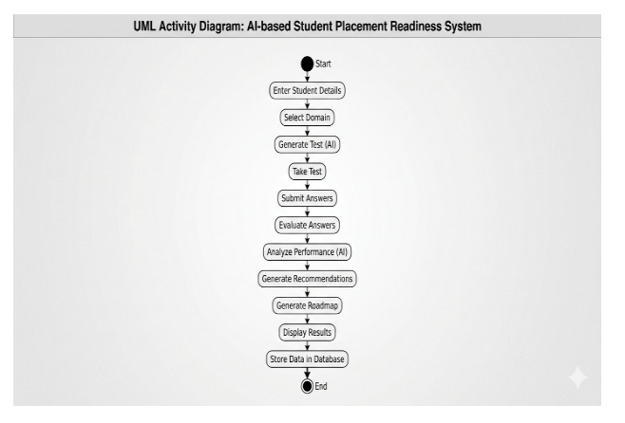
Activity Diagram

Slide 16
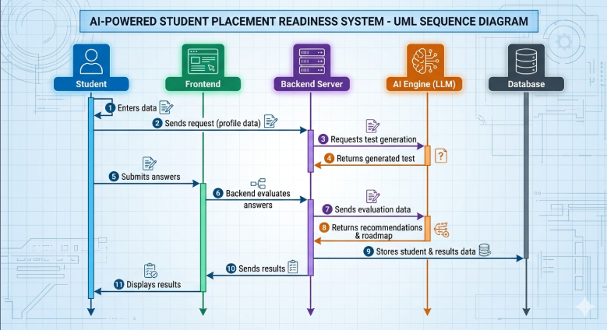
Sequence Diagram

Slide 17
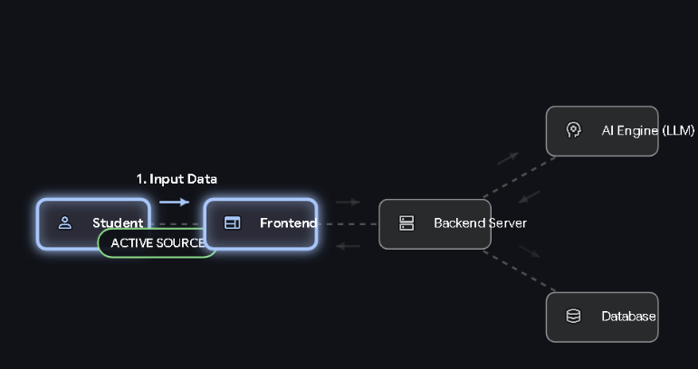
Collaboration Diagram(If applicable)

Slide 18
UNIT TESTING
Unit testing involves testing individual components or modules of the system separately to ensure that each unit works correctly. In this project, unit testing is applied to functions such as data preprocessing, feature selection, and prediction modules.
Each function is tested with different inputs to verify that it produces the expected output. This helps in identifying errors at an early stage and ensures the reliability of individual parts of the system
INTEGRATION TESTING
Integration testing is performed after unit testing to verify that different modules of the system work together correctly. In this project, modules like data preprocessing, model training, and prediction are integrated and tested.
The main objective is to ensure smooth data flow between modules and to identify any issues arising due to module interaction. This testing ensures that the combined system functions as expected.

Slide 19
SYSTEM TESTING
System testing is performed on the complete and fully integrated system to evaluate whether it meets the specified requirements. In this project, system testing involves testing the entire loan elegibility prediction intention prediction system, including data input, preprocessing, model prediction, and output display.
The goal is to ensure that all components work together correctly as a whole system. It checks overall performance, accuracy, reliability, and system behavior under different conditions. This testing confirms that the system meets user requirements and works efficiently in a real-world environment.
FUNCTIONAL TESTING
Function testing, also known as functional testing, focuses on verifying that each function of the system operates according to the specified requirements. In this project, it ensures that all functionalities such as data input, preprocessing, model training, and prediction are working correctly.
It checks whether the system produces accurate results for given inputs and whether all features perform their intended tasks. Functional testing helps ensure that the system behaves correctly from the user’s perspective and meets all functional requirements.

Slide 20
RESULTS AND DEMONSTRATION
Results
The system successfully analyzes student academic data, skills, and interests
Accurately predicts placement readiness level (e.g., Ready / Needs Improvement)
AI-based tests effectively identify strengths and weak areas
Personalized feedback improves student performance over time
Demonstration
User (student) logs into the system
Enters details: marks, skills, domain interest
System generates AI-based domain-specific test
Student completes the test online
System evaluates answers instantly
Displays:
Placement readiness score
Strengths and weaknesses
Provides:
Personalized feedback
Recommended resources (videos/articles)
Day-wise improvement roadmap
Admin/college can monitor student progress via dashboard

Slide 21
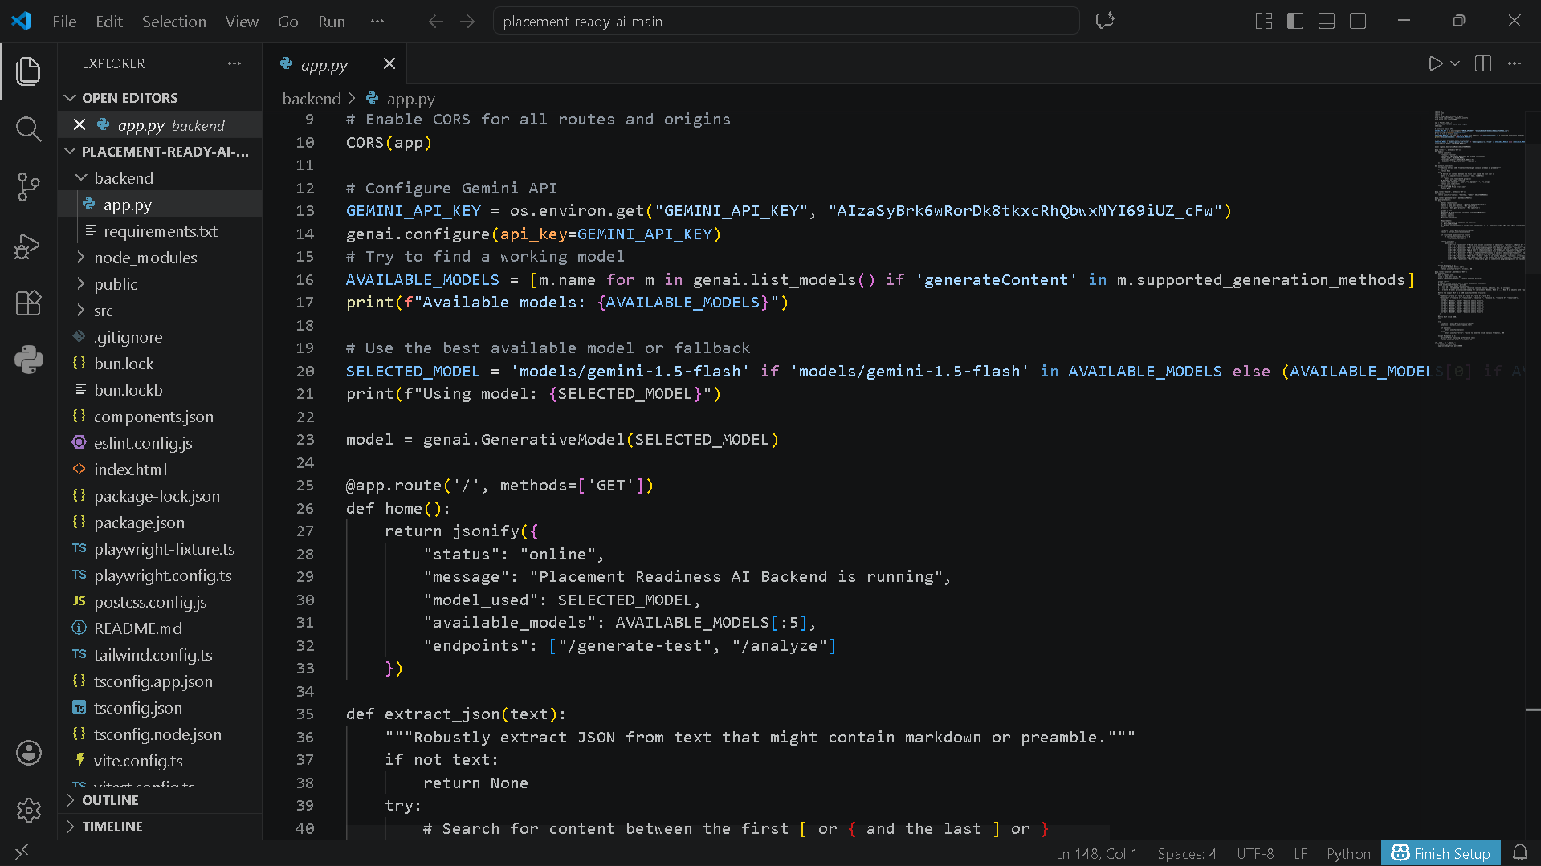
SOURCE CODE

Slide 22
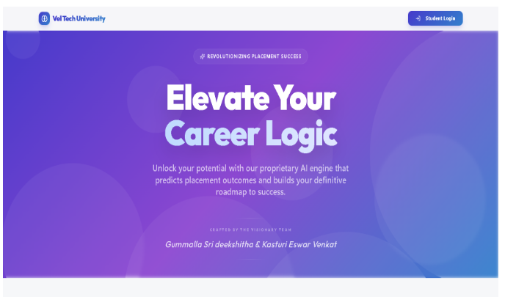
OUTPUT

Slide 23
CONCLUSION
The project successfully develops an AI-powered system for student performance analysis and placement
readiness prediction
It goes beyond traditional methods by combining prediction, assessment, and personalized guidance
The AI-based tests effectively identify student strengths and weaknesses
Personalized feedback and roadmap help students improve in targeted areas
The system enables data-driven decision-making for both students and institutions
Cloud integration ensures efficient data management and scalability

Slide 24
REFERENCES
A. Kumar, R. Singh, “Student Performance Prediction Using Machine Learning,” IEEE Conference on AI & Data Science, 2019
S. Patel, M. Shah, “An Intelligent System for Placement Prediction,” IEEE International Conference on Computing, 2020
J. Lee, K. Park, “AI-Based Adaptive Learning and Assessment System,” IEEE Access, 2021
P. Verma, S. Gupta, “Cloud-Based Student Analytics System for Career Guidance,” IEEE Cloud Computing Conference, 2023
I. Goodfellow, Y. Bengio, A. Courville, Deep Learning, MIT Press, 2016
T. Hastie, R. Tibshirani, J. Friedman, The Elements of Statistical Learning, Springer, 2009

Slide 25

THANK YOU

